Slide 1
Tutorial machine learning in solid mechanics
Task 3 – Viscoelasticity

Slide 2
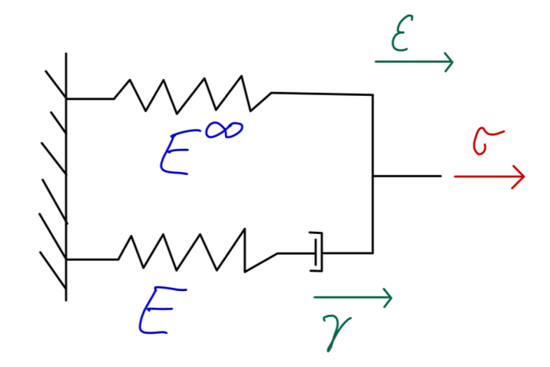
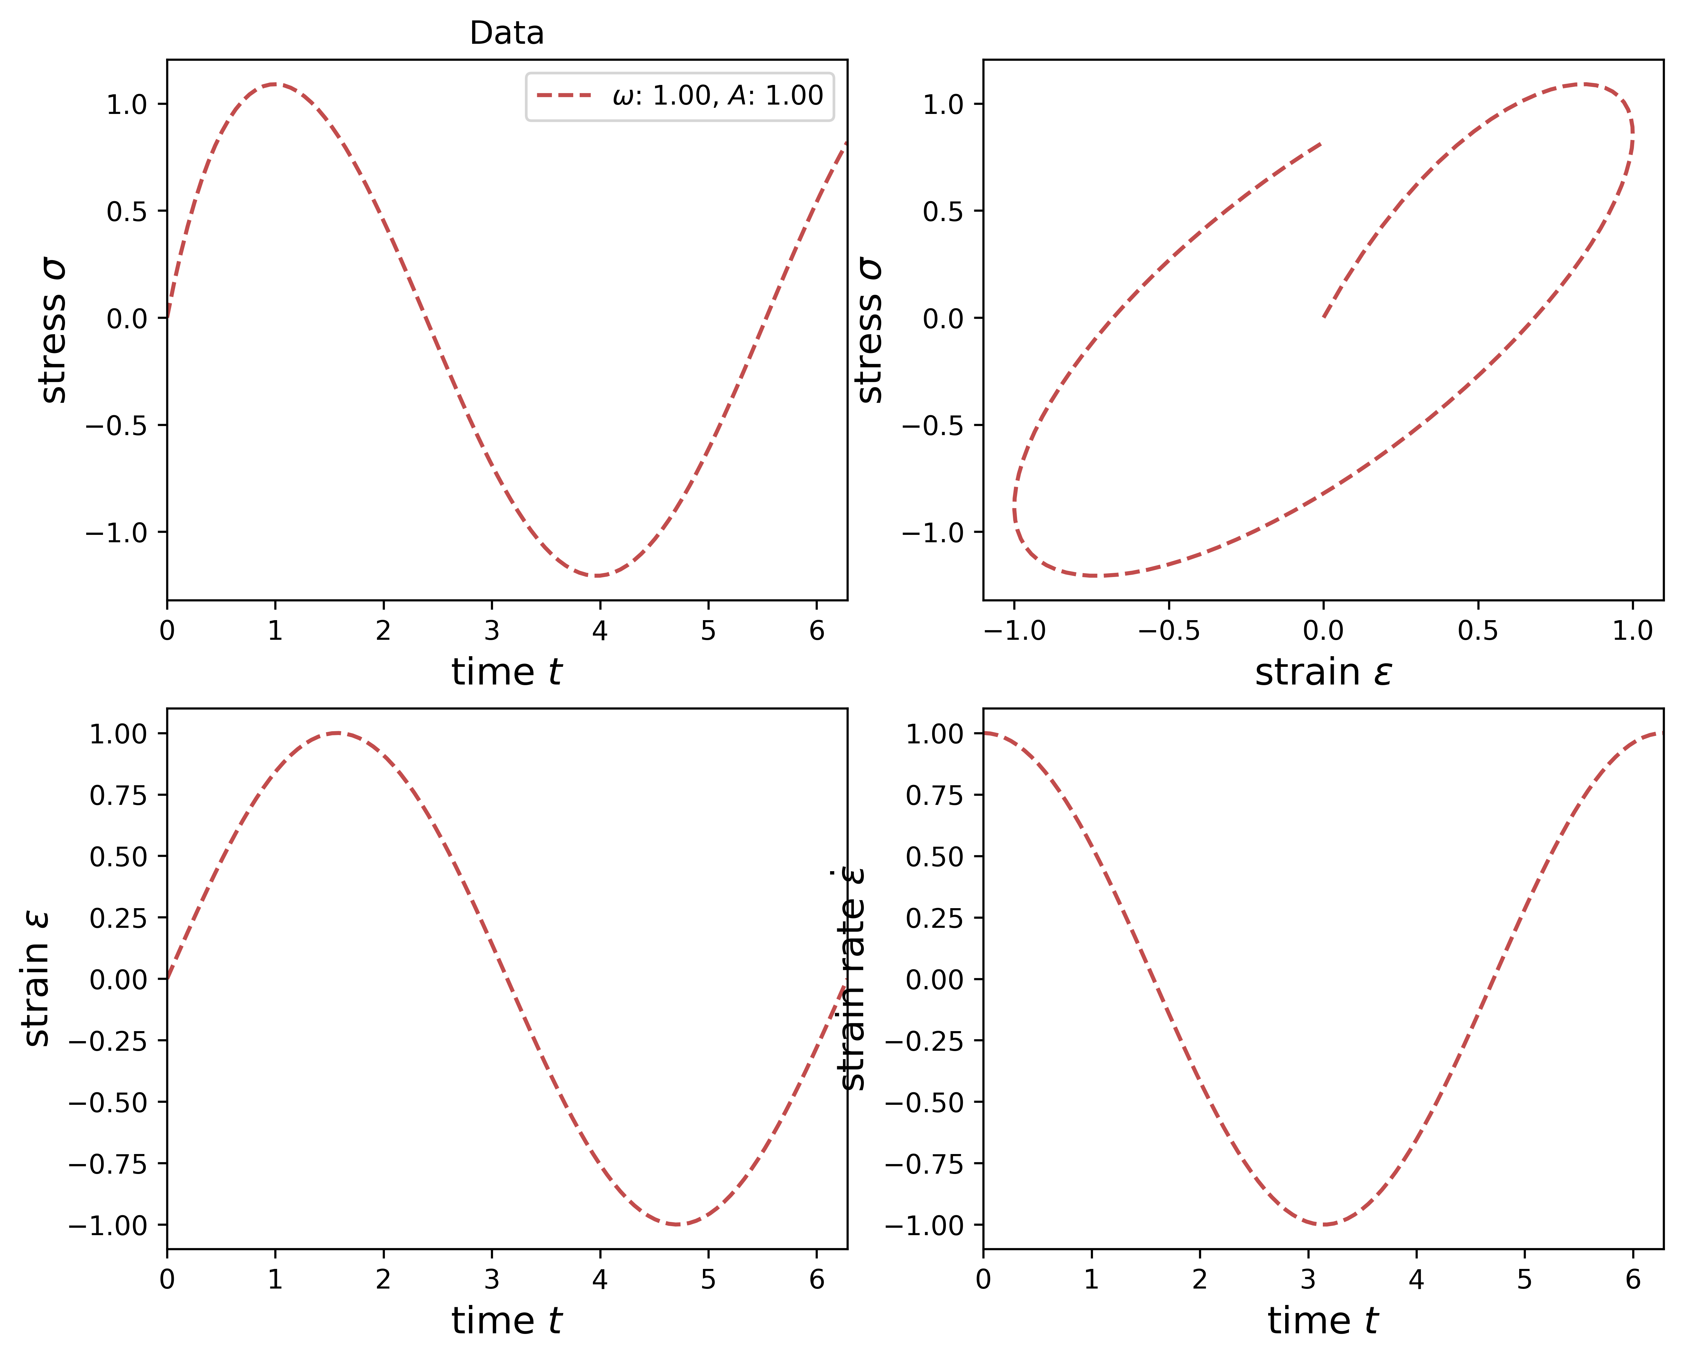
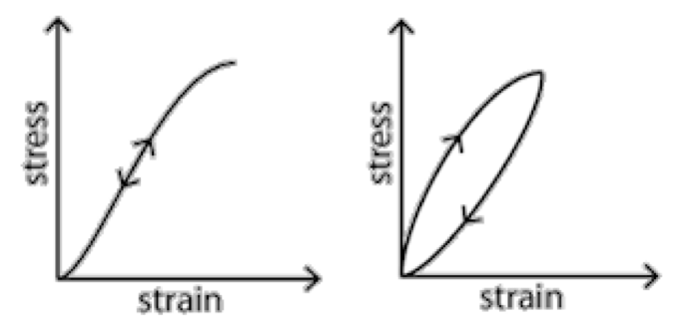
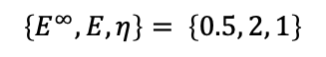
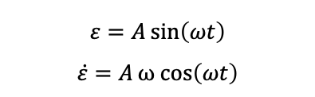

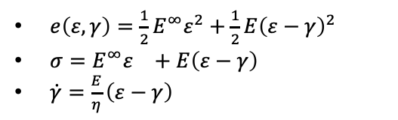
Introduction
Simple RNN
Maxwell Model
Generalized Standard Materials
summary
So far we have dealt with elastic materials (dissipation free)
Now we consider inelastic materials
Energy is dissipated
Stress-strain relation is rate- or path-dependent
Maxwell model for describing the viscoelastic behavior of materials
Maxwell model:
Harmonic oscillation:
Explicit euler scheme:
$e\left(ε,γ\right)=\frac{1}{2}E^{∞}ε^{2}+\frac{1}{2}E{\left(ε−γ\right)}^{2}$
$σ=E^{∞}ε^{}+E{\left(ε−γ\right)}^{}$
$\dot{γ}=\frac{E}{η}{\left(ε−γ\right)}^{}$
$$γ_{n+1}=γ_{n}+∆t_{n}\frac{E}{η}\left(ε_{n}−γ_{n}\right)$$
Parameters:
$$\left\{E^{∞}, E, η\right\}= \left\{0.5, 2, 1\right\}$$
$$ε=A\sin\left(ωt\right)$$
$$\dot{ε}=Aω cos\left(ωt\right)$$
Notes:
-

Slide 3
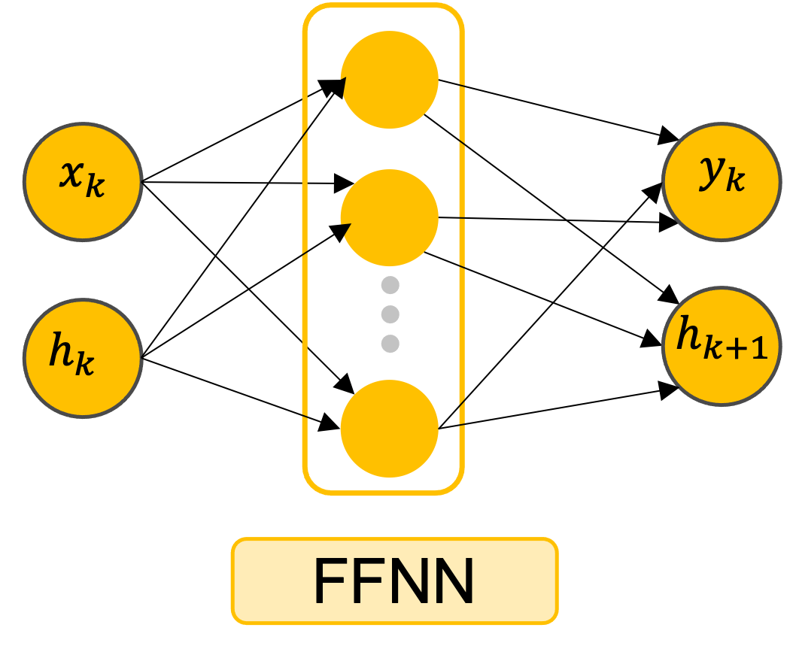
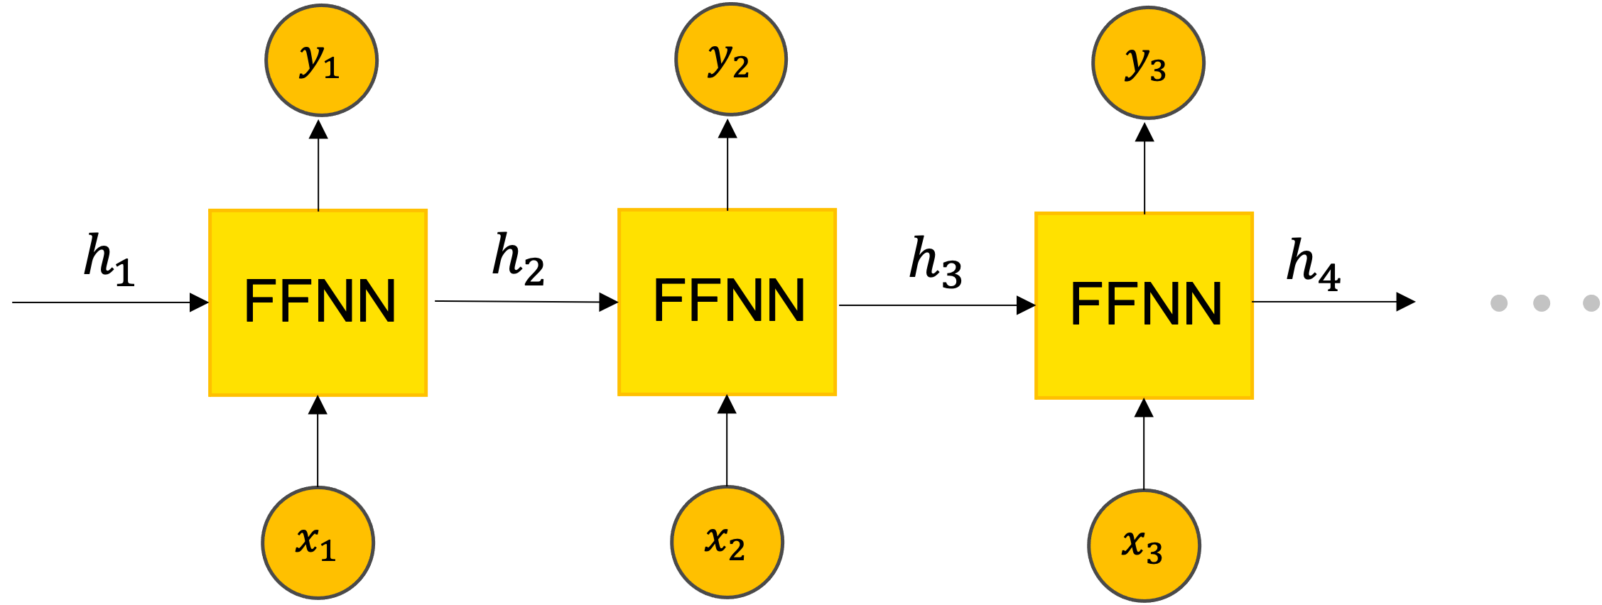
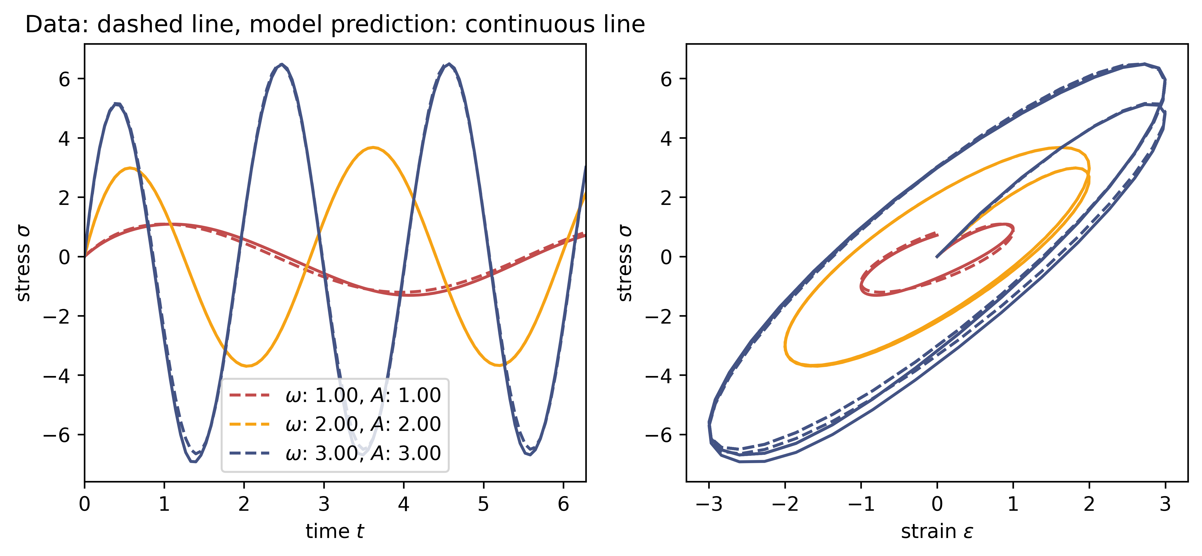
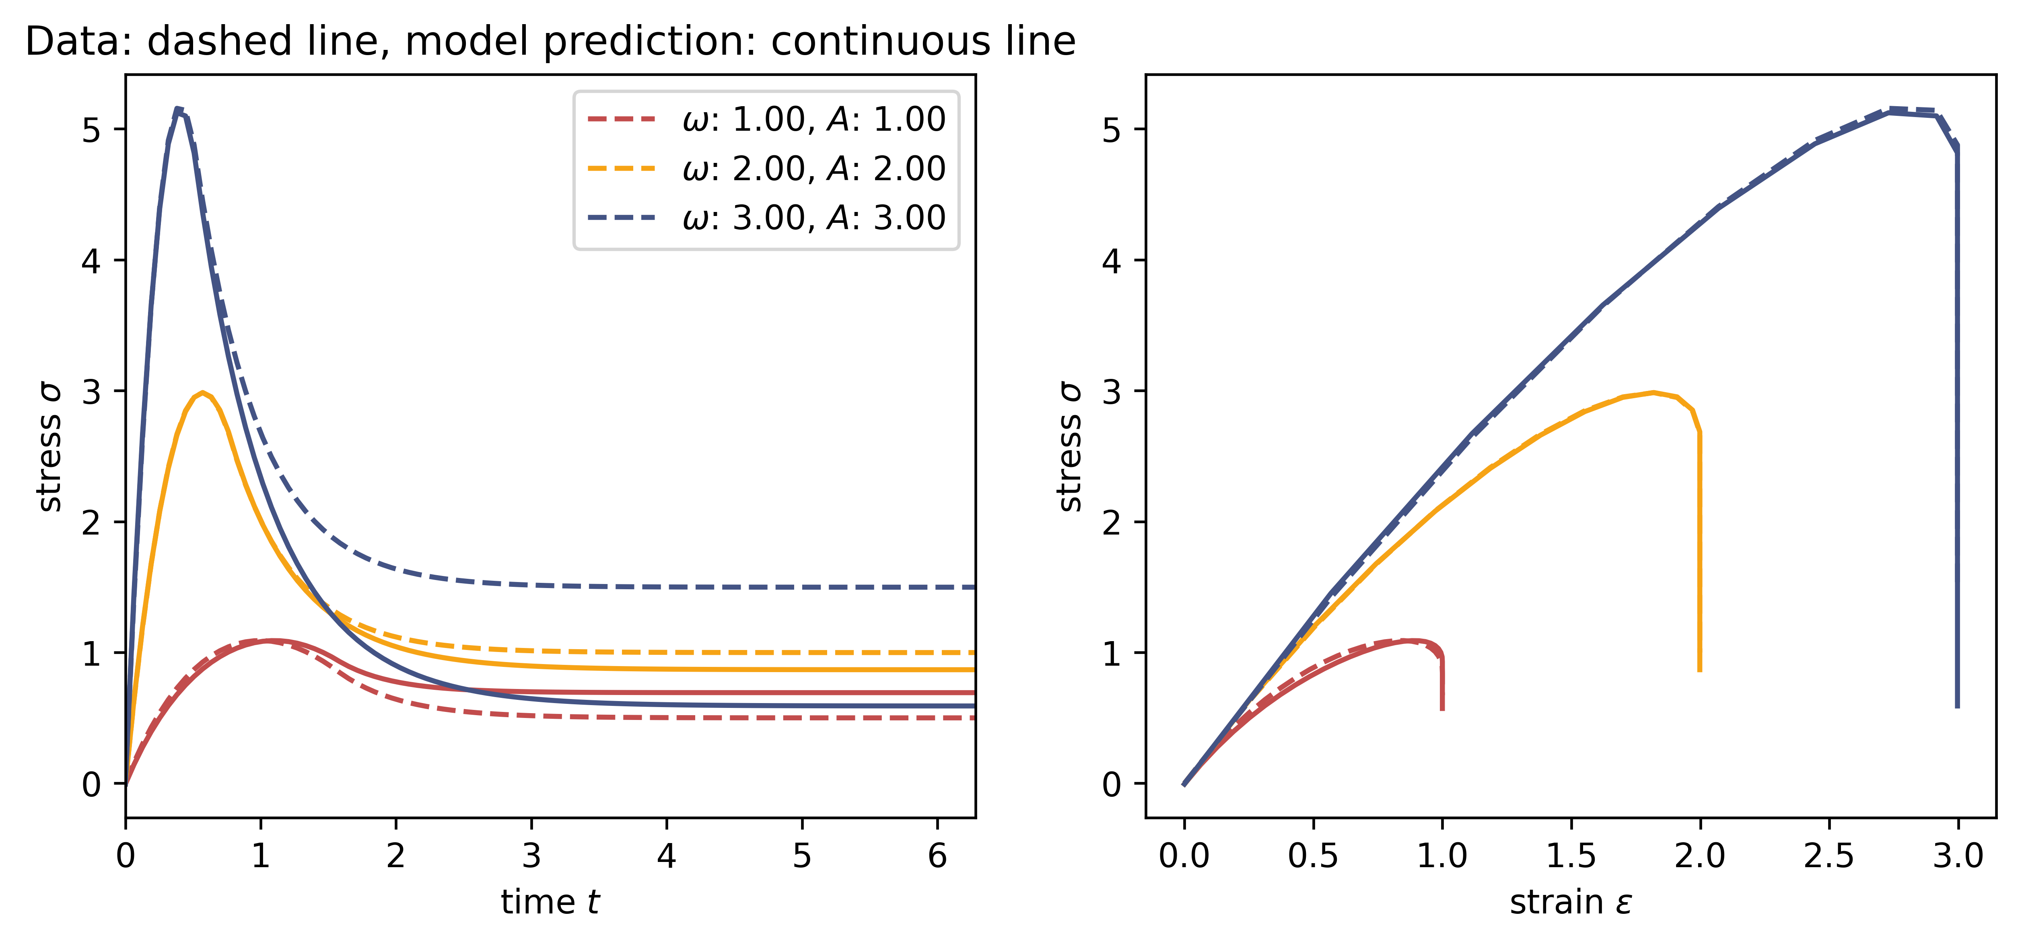
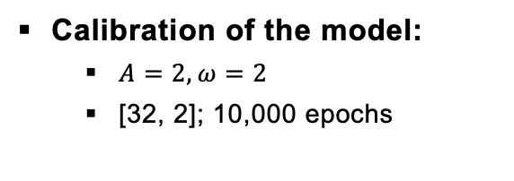
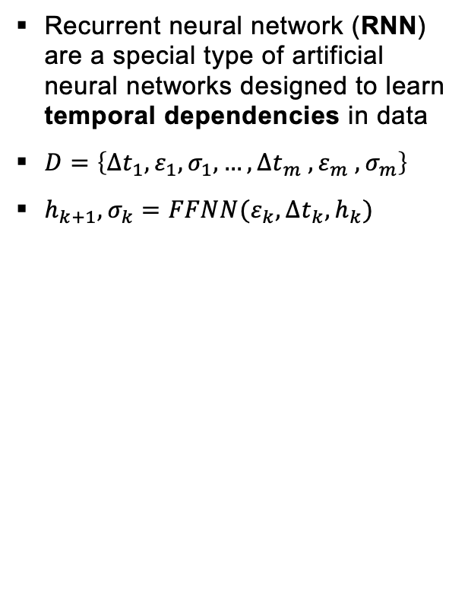
Introduction
Simple RNN
Maxwell Model
Generalized Standard Materials
summary
Recurrent neural network (RNN) are a special type of artificial neural networks designed to learn temporal dependencies in data
$D=\left\{∆t_{1}, ε_{1}, σ_{1}, …,∆t_{m} , ε_{m} , σ_{m}\right\}$
$h_{k+1}, σ_{k}=FFNN(ε_{k},∆t_{k}, h_{k})$
Calibration of the model:
$A=2, ω=2$
[32, 2]; 10,000 epochs
Model without any prior knowlegde
Extrapolation behavior acceptable
Predictions depend on time step size
Thermodynamic consistency not fulfilled!
Notes:
RNN is a series-connected FFNN
Hidden state: Memory structure

Slide 4
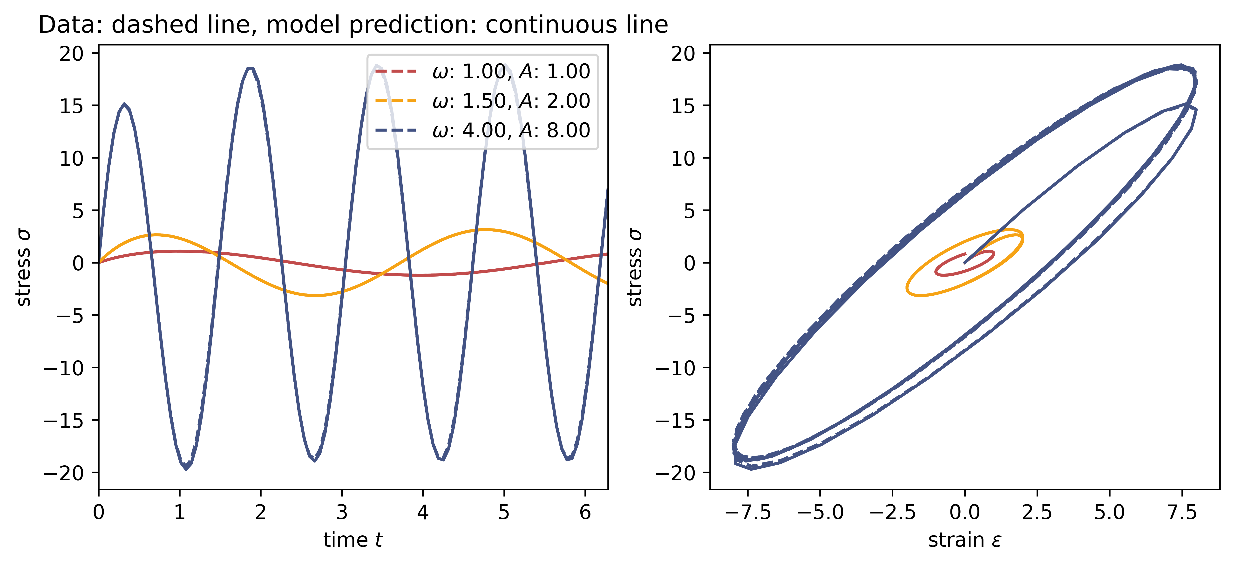
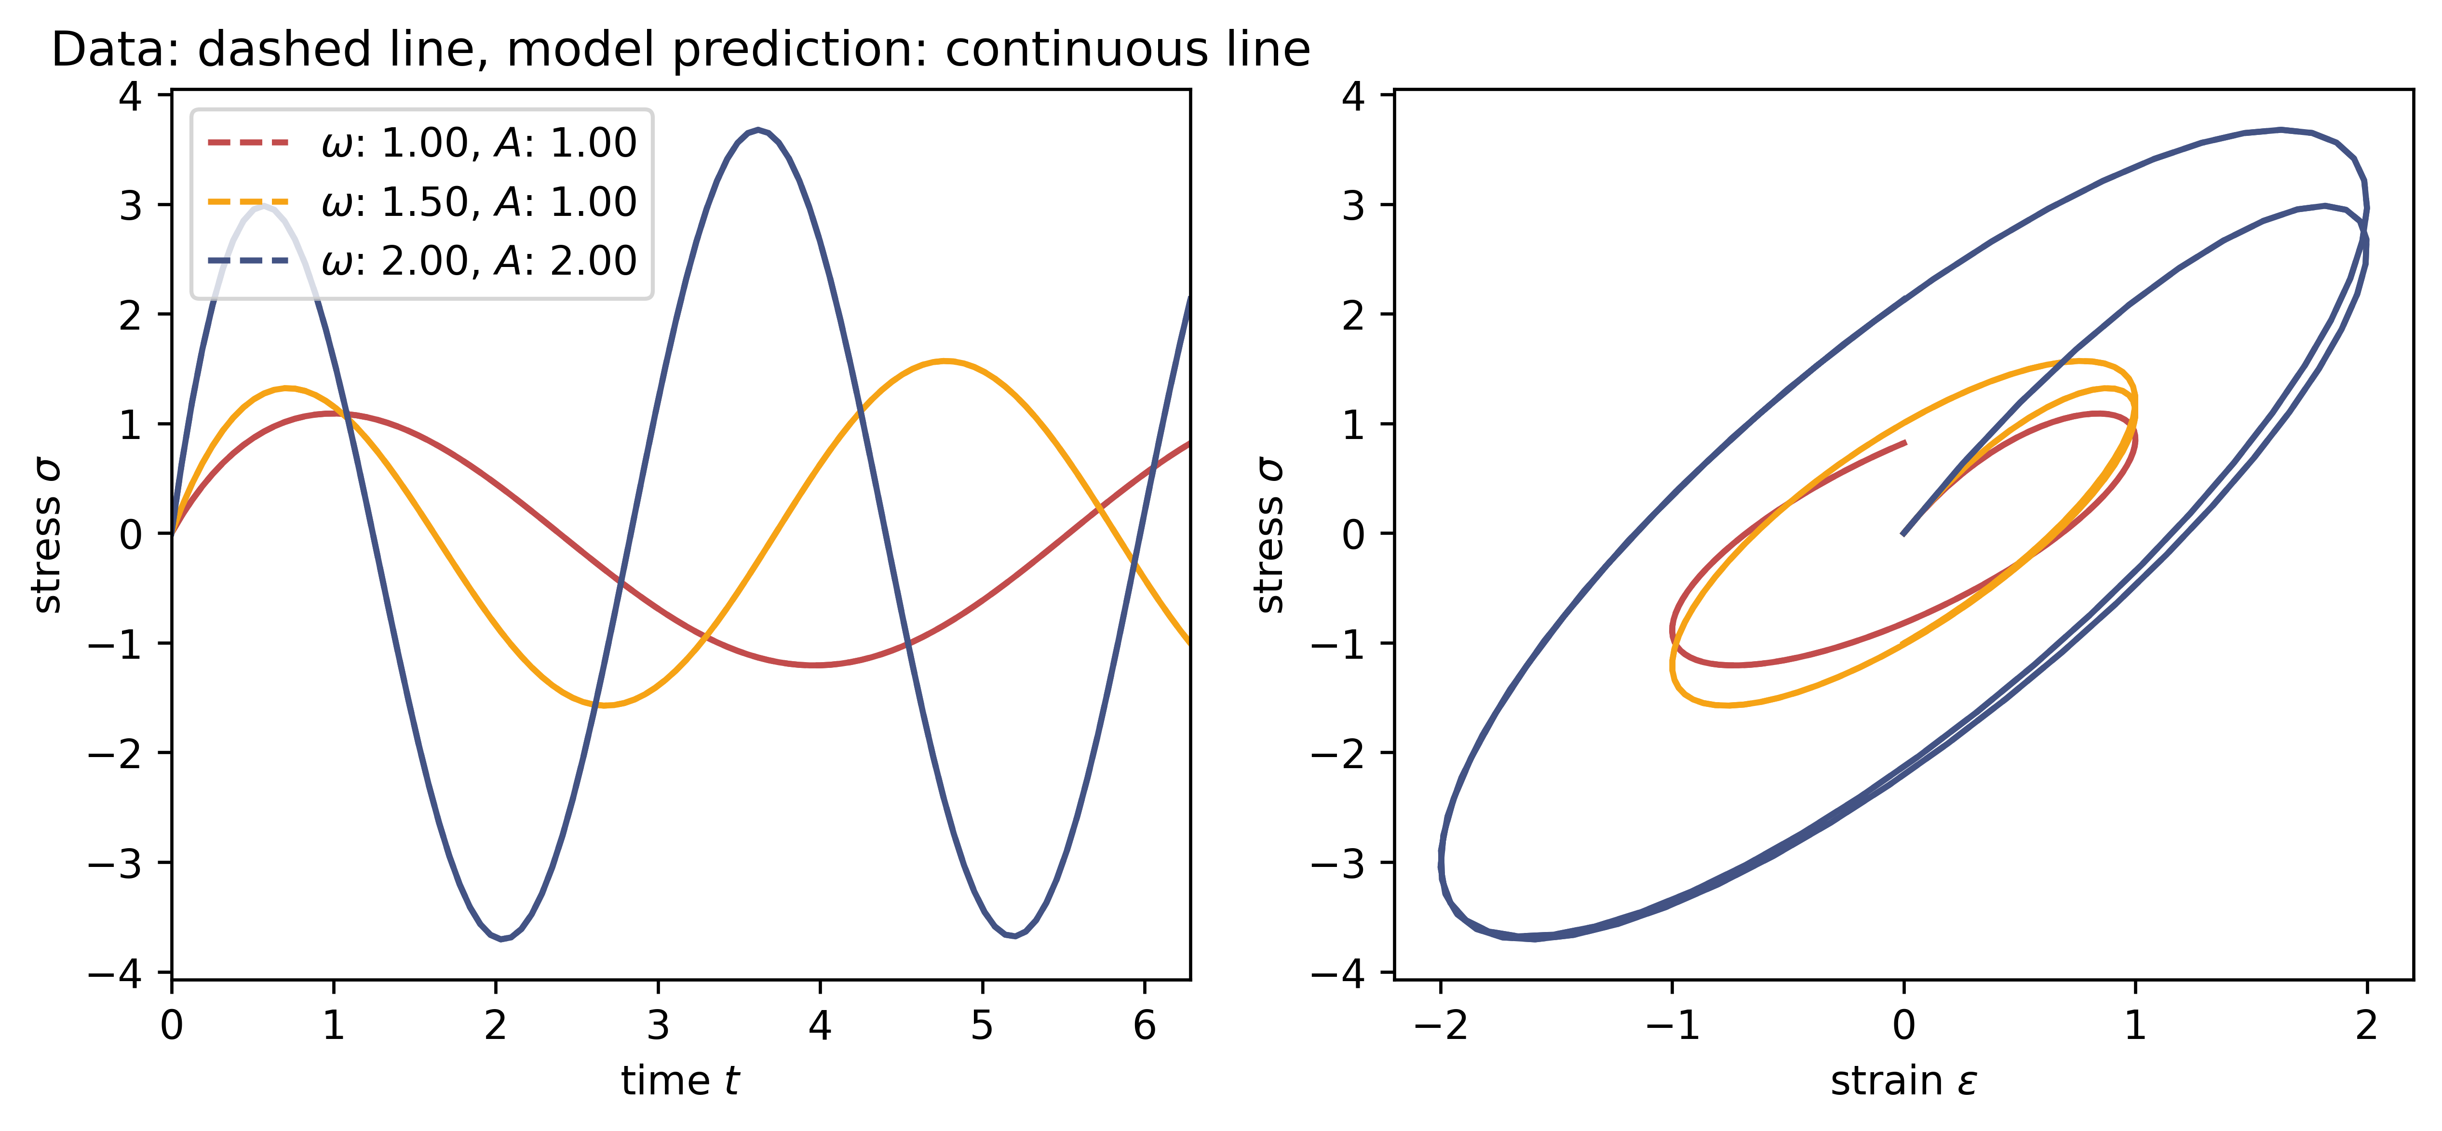
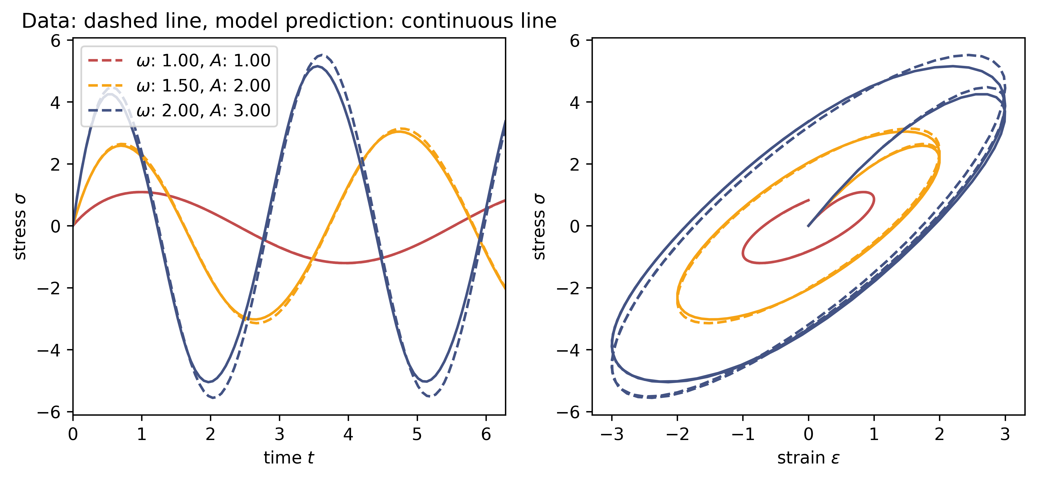
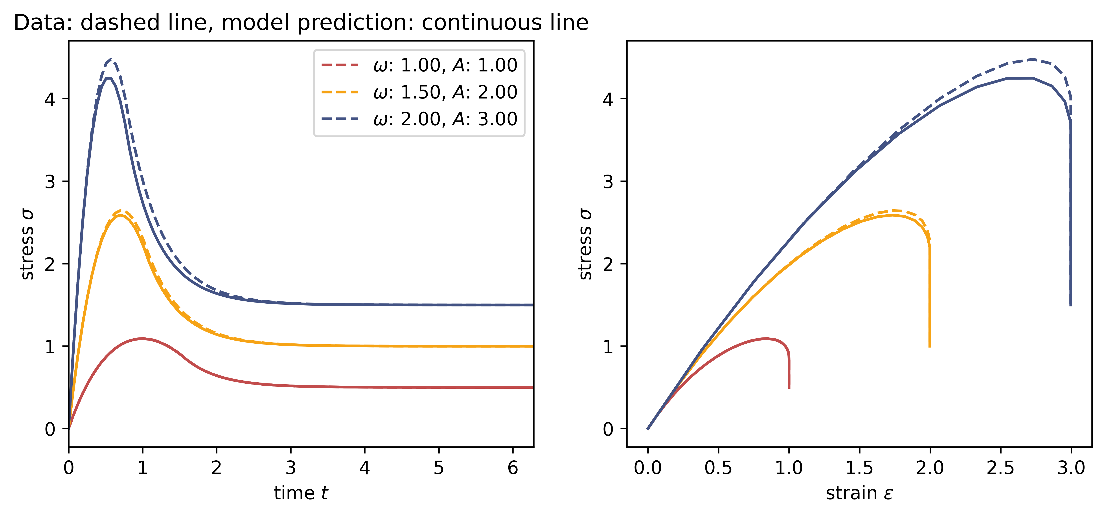
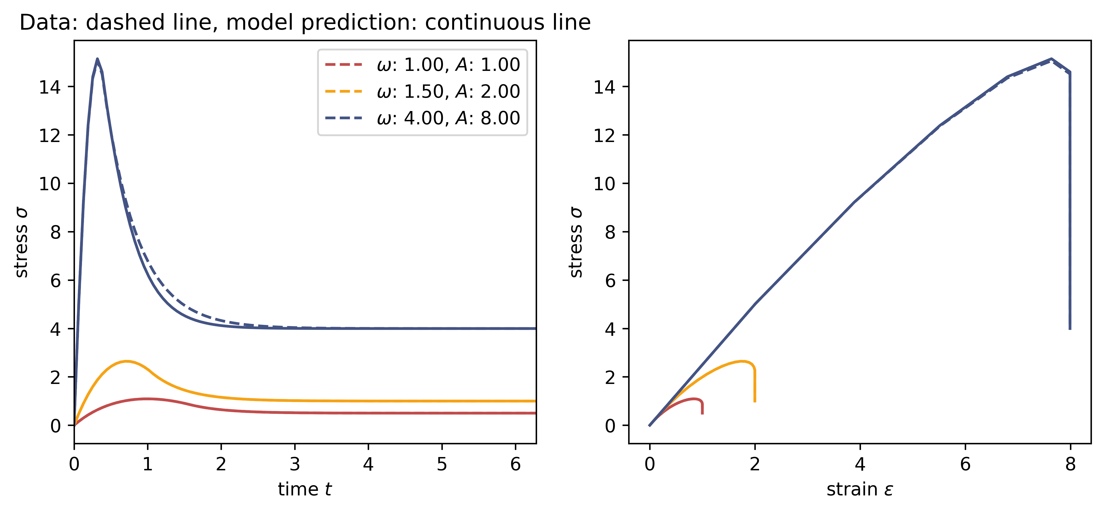
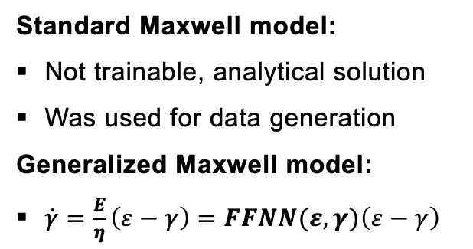
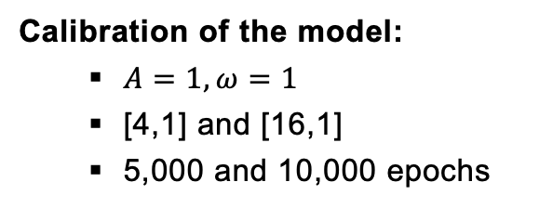
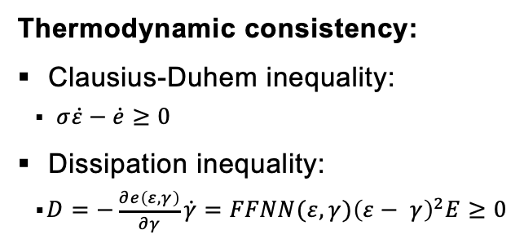
Introduction
Simple RNN
Maxwell Model
Generalized Standard Materials
Summary
Standard Maxwell model:
Not trainable, analytical solution
Was used for data generation
Generalized Maxwell model:
$\dot{γ}=\frac{E}{η}\left(ε−γ\right)=FFNN(ε,γ){\left(ε−γ\right)}^{}$
Calibration of the model:
$A=1, ω=1$
[4,1] and [16,1]
5,000 and 10,000 epochs
Thermodynamic consistency:
Clausius-Duhem inequality:
$σ\dot{ε}−\dot{e}≥0$
Dissipation inequality:
$D=−\frac{∂e\left(ε, γ\right)}{∂γ}\dot{γ}=FFNN(ε,γ){\left(ε− γ\right)}^{2}E≥0$
Standard Maxwell Model is our basis
GMM more flexible, but we only approx. a constant!
Extrapolation behavior increase with NN size

Slide 5
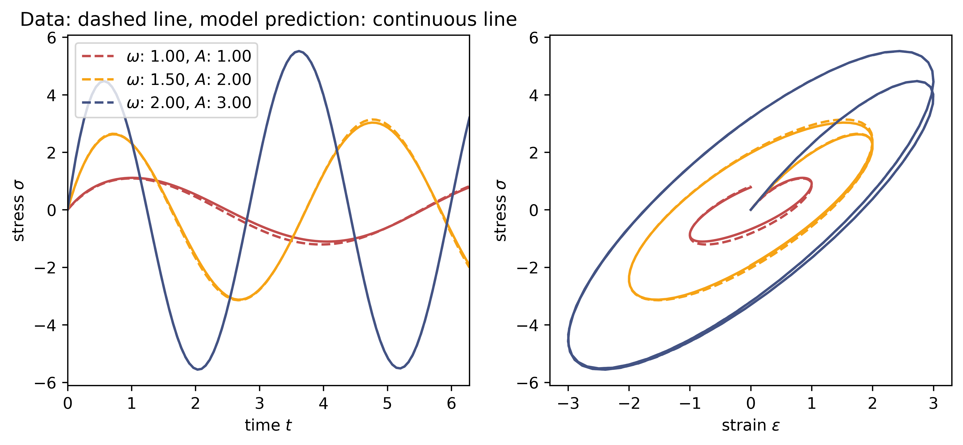
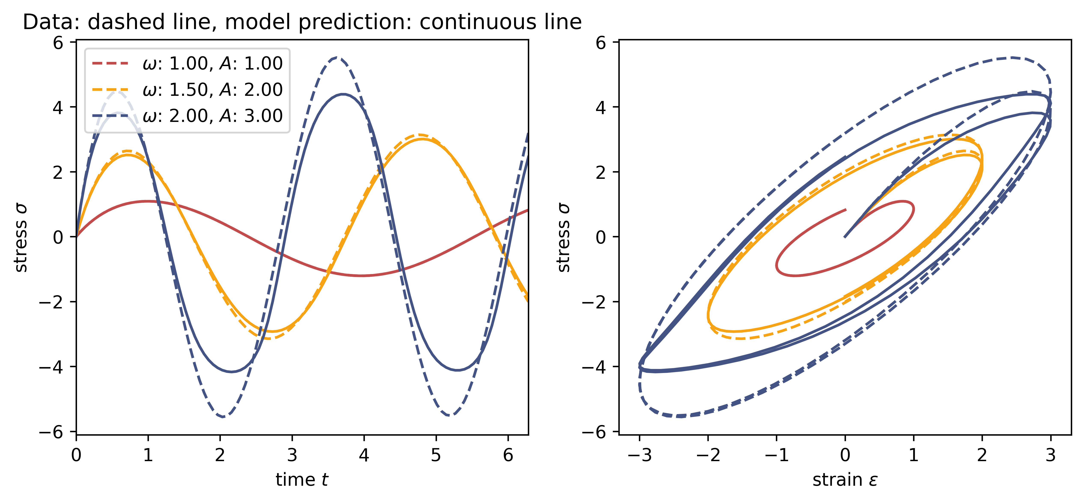
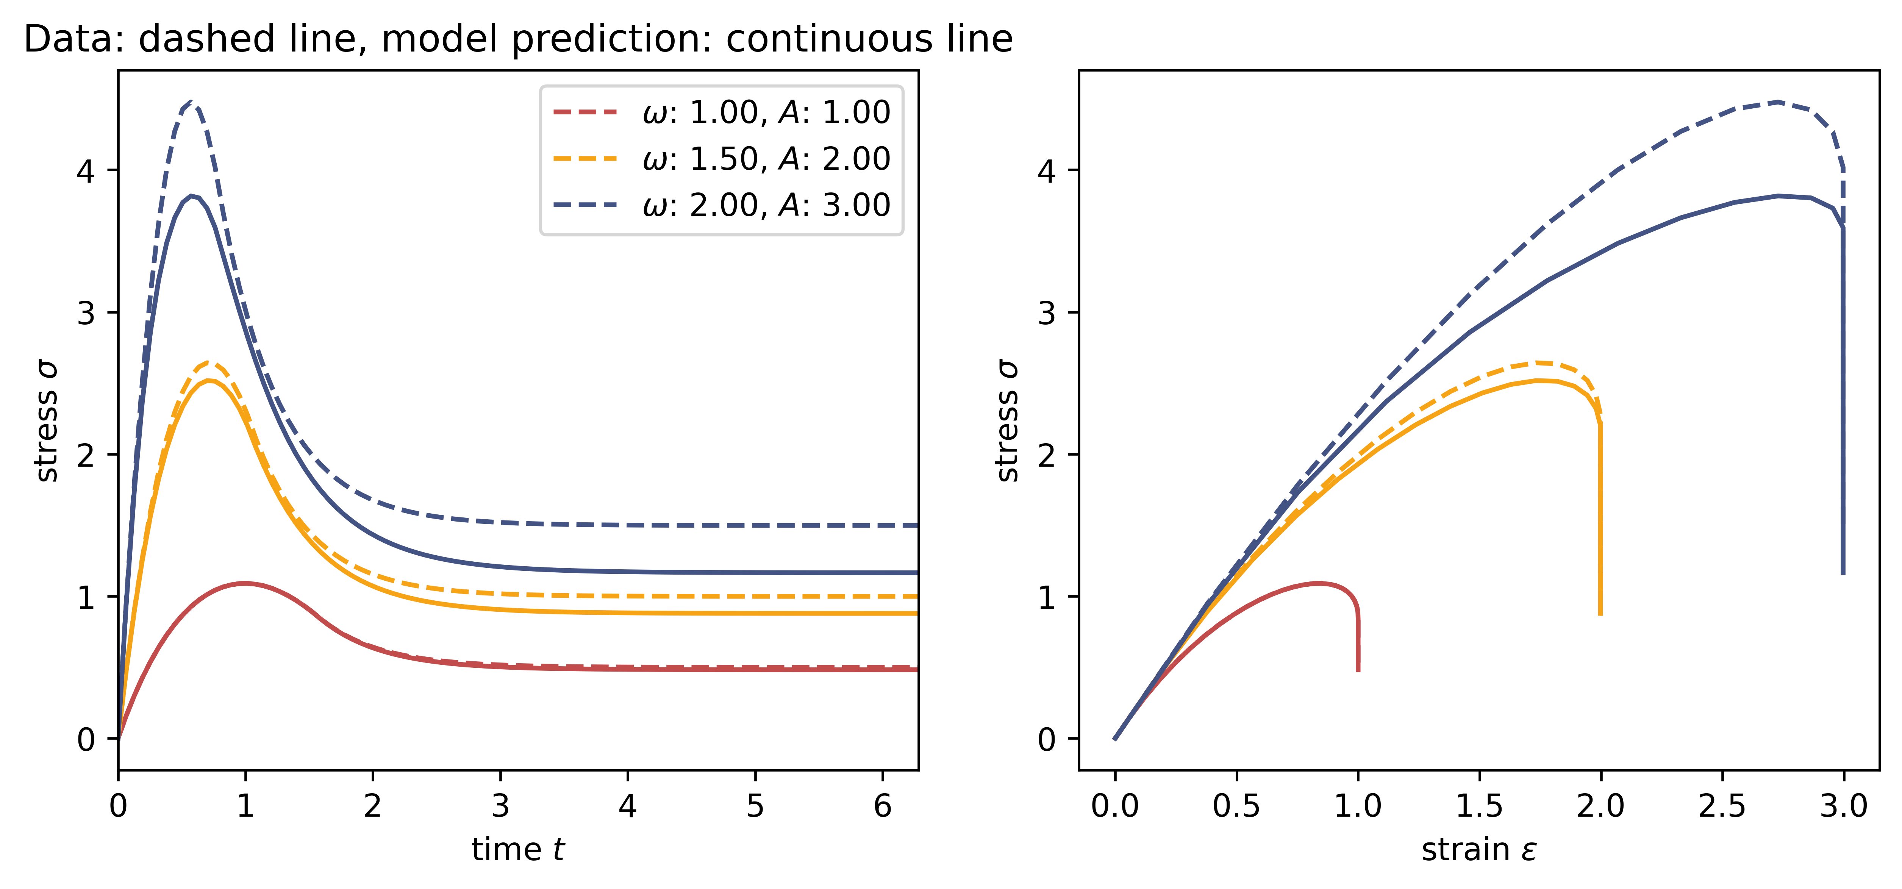
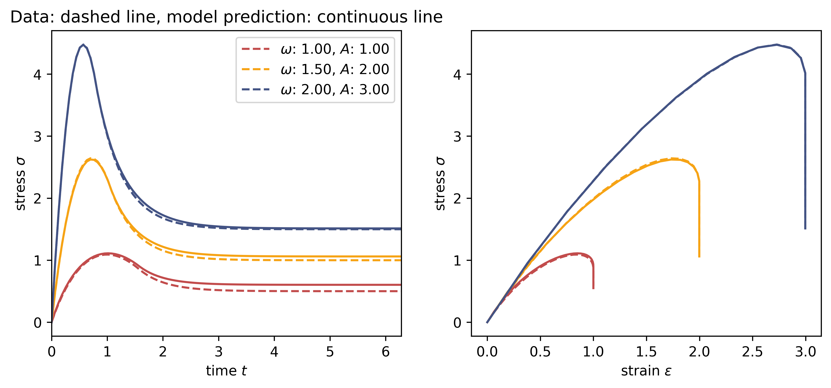
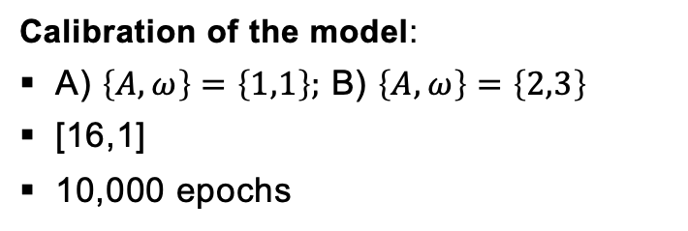
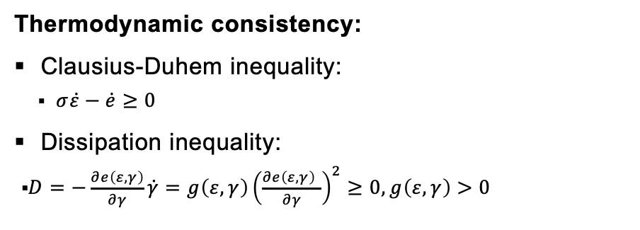
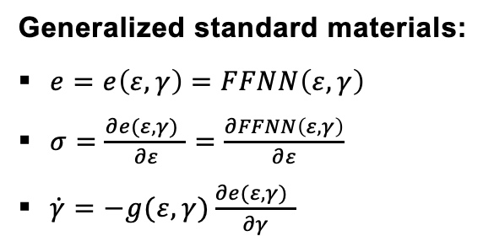
Introduction
Simple RNN
Maxwell Model
Generalized Standard Materials
Summary
Generalized standard materials:
$e=e\left(ε,γ\right)=FFNN\left(ε,γ\right)$
$σ=\frac{∂e(ε,γ) }{∂ε}=\frac{∂FFNN\left(ε,γ\right)}{∂ε}$
$\dot{γ}=−g(ε,γ)\frac{∂e(ε,γ) }{∂γ}$
Calibration of the model:
A) $\left\{A,ω\right\}=\left\{1,1\right\};$ B) $\left\{A,ω\right\}=\left\{2,3\right\}$
[16,1]
10,000 epochs
Thermodynamic consistency:
Clausius-Duhem inequality:
$σ\dot{ε}−\dot{e}≥0$
Dissipation inequality:
$D=−\frac{∂e\left(ε, γ\right)}{∂γ}\dot{γ}=g\left(ε,γ\right){\left(\frac{∂e\left(ε,γ\right) }{∂γ}\right)}^{2}≥0, g\left(ε,γ\right)>0$
Intrapolation very good if trained for larger amplitudes and frequencies
Thermodynamic consistency is ensured through the dissipation potential
Not great influence of time

Slide 6
Introduction
Simple RNN
Maxwell Model
Generalized Standard Materials
Summary
Implementation of:
Simple RNN
Thermodynamic consistency is not fulfilled
Generalized Standard Materials
Thermodynamic consistency is fulfilled
Maxwell model
Analytical solution
Thermodynamic consistency is important for neural networks to learn the physics in the data!
The more physics we embed, the …
smaller the NN
more robust the results
less data
better the generalization
compared to a standard data-driven model!

Slide 7
Introduction
Simple RNN
Maxwell Model
Generalized Standard Materials
Summary
Simple RNN:
No prior knowledge
Extrapolation to unseen data is not perfect but acceptable.
Thermodynamic consistency is not fulfilled.
Since time is an input parameter, the result is strongly dependent on time
Generalized Standard Materials:
Intrapolation very good if trained for larger amplitudes and frequencies
Thermodynamic consistency is ensured through the dissipation potential.
Not great influence of time
Notes:
-

Slide 8
Thank you for your attention!

Slide 9
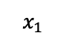
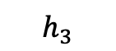
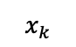
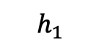
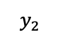
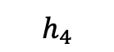
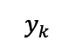
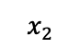
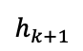
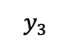
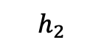
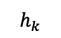
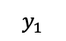
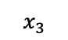
RNN
$$y_{1}$$
$$y_{2}$$
$$y_{3}$$
$$x_{k}$$
$$y_{k}$$
$$h_{1}$$
$$h_{2}$$
$$h_{3}$$
$$h_{4}$$
FFNN
FFNN
FFNN
$$h_{k}$$
$$h_{k+1}$$
$$x_{1}$$
$$x_{2}$$
$$x_{3}$$
FFNN
Notes:
-The first task consisted mainly of data preparation and data visualization
The data is generated synthetically by evaluating a hyperelastic potential
The dataset consists of triplets for the corresponding deformation gradient tensor F, the Stress tensor, and the strain energy density
We have different kind of deformation: uniaxial, biaxial, shear, mixed
A uniaxial load path is shown here as an example

